Slide 1
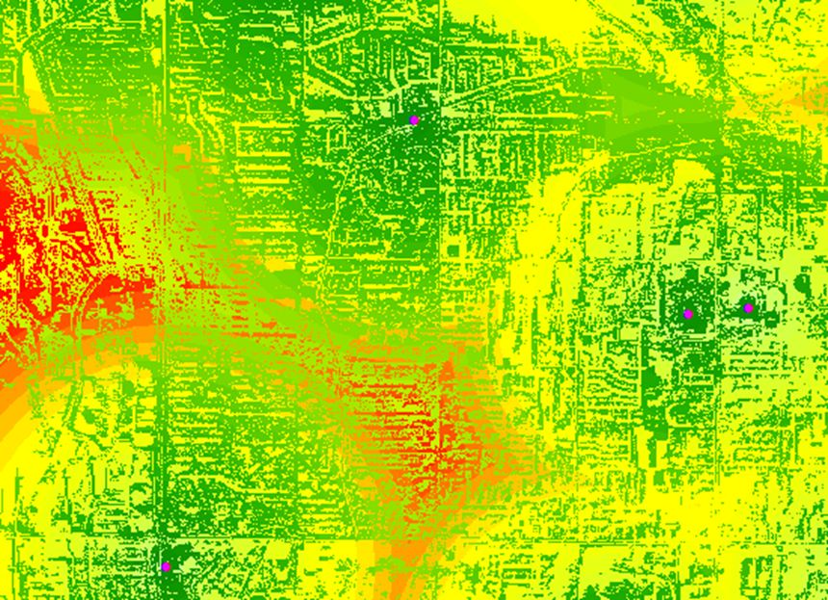
Visualizing Geography Matters
Prepared by A.J. Allred, WPCS Site Plan Inc., March 2011
All rights reserved – no use or reproduction without permission

Slide 2
Notes:
Some graphics have been file-compressed or are of reduced resolution to ease file transfer. Higher resolution graphics may be available.
This version does not contain all documentation, referencing, credits or other notes and should not be distributed without proper attribution available or disclaimer.
Some notes and “talking points” have been placed on-screen in lieu of oral delivery.
This work is the sole property of the author and should not be used or cited in any way without permission

Slide 3
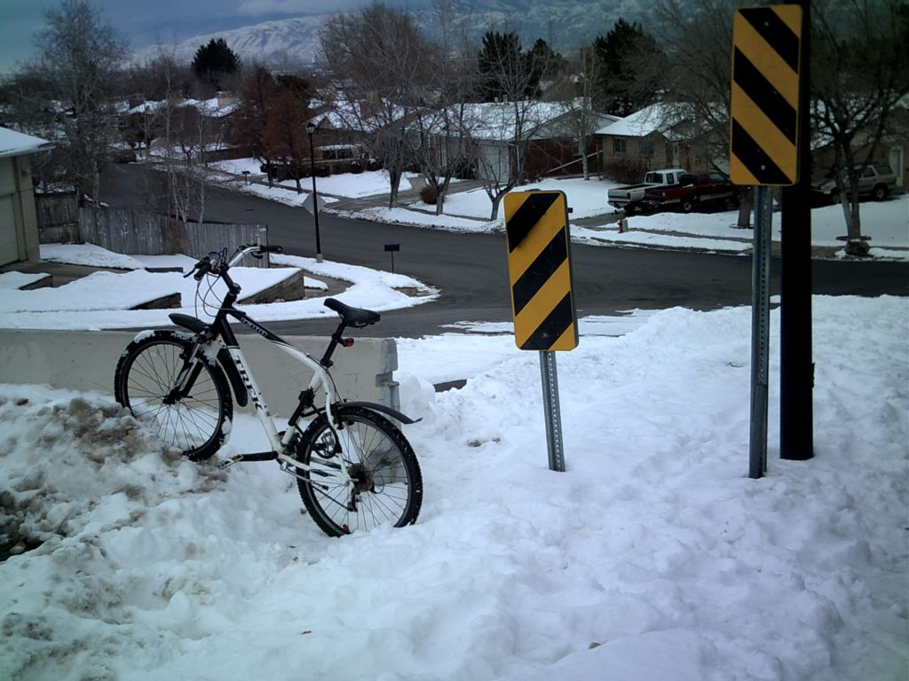
Introductory personal noes:
Cogito ergo sum –
I bike therefore I exist.
As a former city planner,
my research on non-motorized
travel revealed weakness
in community planning
and reporting systems.
Citizen involvement in
planning processes
(VGI – UGI) is enhanced
by mobile communication capability and real-time municipal evaluation systems.
Antoni J. Allred:
12 years in city planning
2 years in wireless site acquisition
5 years managing city involvement
5 years in energy management
6 years college teaching
1 year GPS field work
51 years on a bicycle

Slide 4
Research for VGI as a community process included analysis of “dead zones” for wireless signal.
My concern is for the
wireless “last mile”
– national resources
(such as national map)
can inform ‘bottom-up’
processes where local
land use control and
ireless signal really matter.
We talk about walking, then build for cars
We rely on cell phones, but hamper their signals

Slide 5
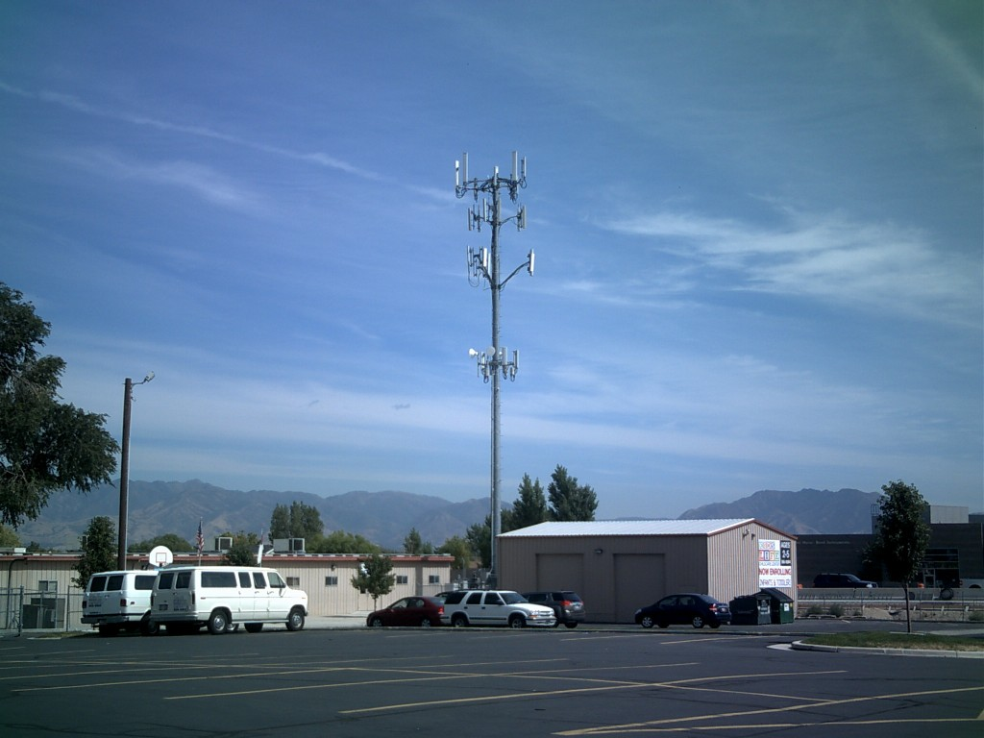
My First Cell Tower Approval - 1996
Having worked “both sides of the counter” in public and private organizations proved the value of visualizing networks within regulatory environments.

Slide 6
Forbes Magazine recently ranked Utah first in the nation for business, including criteria for technology, government efficiency and regulatory sensibility.
Talking points: “Preaching to the choir” or not, we are using APA/ASLA/UGIC/AIA/ULI for building our arguments.

Slide 7
Democracy 2.0: Down-Top VGI – UGI Mobile communication World-wide Web Invention & innovation Crowd-sourcing Social Networking
Published March 2011

Slide 8
Is Utah Ready for 4G?
Education | Healthcare
Manufacturing | Retail
Government | Professional services
Wholesale distribution | Technical services
Financial | Service provider
Transportation | Energy
Hospitality | Media/entertainment
“Consider that every one of these key industries relies entirely on its own ecosystems of suppliers, partners, and customers…the geographic diversity of these elements, the essential nature of wireless mobility is apparent.” Wireless Mobility: The Why of Wireless, McGraw-Hill, 2010

Slide 9
GIS as a tool for visualizing wireless broadband
networks in support of UGI
There is evidence that public technology processes are not evolving at the same rate as citizen technology adoption.
The traditional mandate for local agencies and jurisdictions has been for stability, conservatism, predictability and homogeneity. Invention and experimentation are sometimes rewarded, but not nearly as quickly as with business and consumer markets.
Our wireless systems work, but will they work under stress that we see elsewhere in the world? Will they work when we most need them?
GIS software, with integrative power and strong symbology tools addresses these issues.

Slide 10
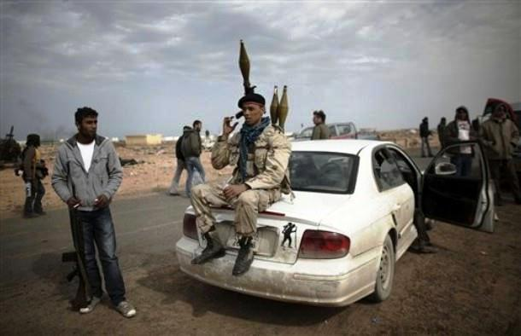
Libya – March 2011
BBC/CNN/NPR commentators recognized the constellation of wireless/broadband mobility issues as key to revolts, but did not recognize wireless signal complexities on which communication is based.

Slide 11
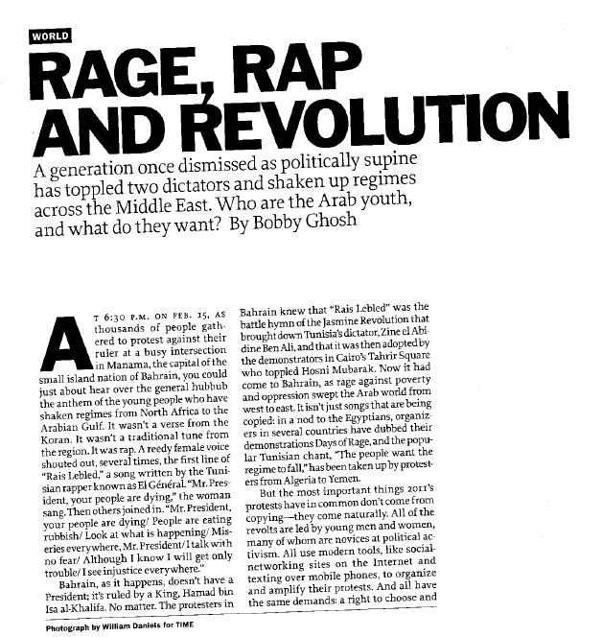
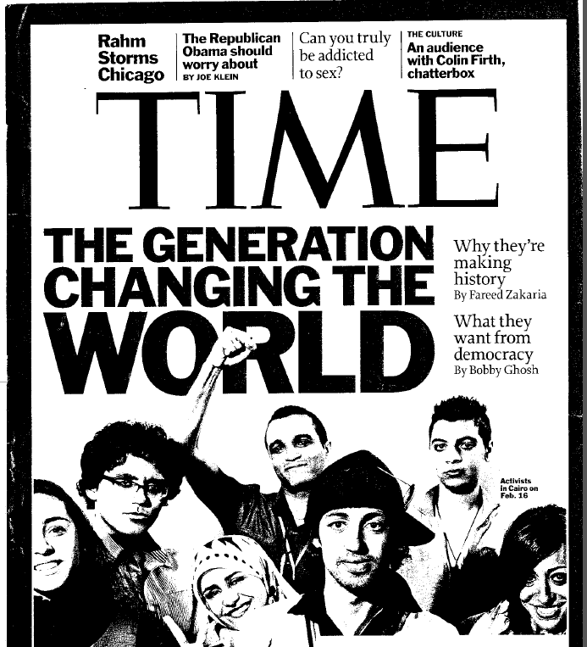
A 2011 issue of TIME magazine with seven features on wireless

Slide 12
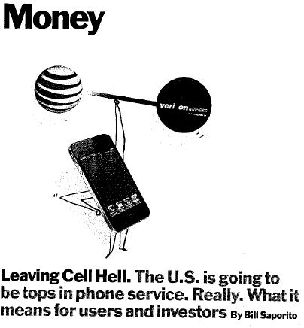
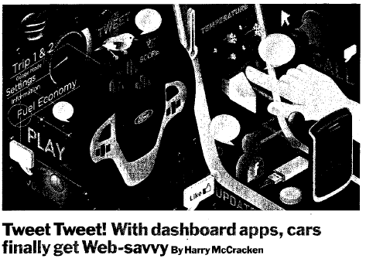
15 years of arguments for a balanced system where all in puts are explicit, including municipal regulation.
Wireless signal and broadband speeds are hard to evaluate.
Manhattan writer with canyon effect
GIS evaluation of four-dimensional traffic

Slide 13
Paradigm of the databases
Source: ESRI
Local newspaper
King and his subject
Many available news media sources
Social networking – each person becomes a mobile broadcasting company – infinite audience

Slide 14
USA is not classically a world leader in mobile communications - - room for growth and pressure on network

Slide 15
Allred found: Motorcyclist in Israel arrested for using two cell phones at a time in traffic.

Slide 16
Talking Points:
Americans are not in top ten nations for cell phones –
but a flood of demand may be coming.
One of Allred’s students sends 20,000 text messages in a month. She puts cell phone in a zip lock bag for texting in the shower.

Slide 17
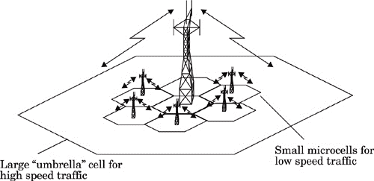
Assurance at both ends, uncertainty in the middle
“Mobile” Wireless
Femtocells:
“Fixed” Wireless
Allred: A college student completes a term paper while driving and Web surfing – arranged for tour of seismic isolation blocks under Utah capitol building, assembled report data, spell-check’d etc.
Some technologies arose in coping with primary signal loss – but you have to buy a cup of coffee to get it
Wireless Mobility: The Why of Wireless, McGraw-Hill, 2010

Slide 18
Cisco Visual Networking Index: Mobile Video Will Generate 66 Percent of Mobile Data Traffic by 2015

Slide 19
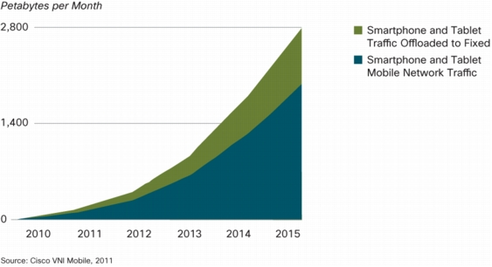
Cisco Visual Networking Index: Offload for dual-mode devices and femto-cells will increase in 1st world countries; decrease in 3rd world countries.

Slide 20
Mobile-Only
Internet Users
2011 – 2015
Cisco Visual Networking Index: Global Mobile Data Traffic Forecast Update, 2010–2015
Consider the mobility of international money…
Current mobile-only users is in its infancy in all world markets

Slide 21
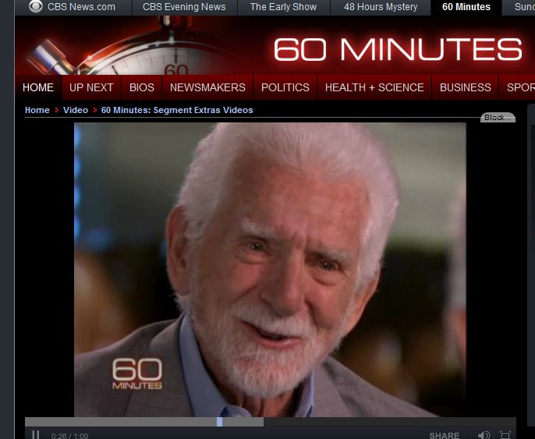
Commentator opined that genuine wireless mobility may be supplanted by femto or fixed wireless . . . in 10 years.

Slide 22
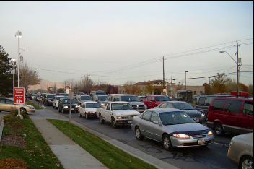
East-west routes in Salt Lake valley are not as well-developed as north-south.
Outlook for highway funding is not good . . . . So . .
. . . do drivers appear tolerant of sitting in traffic because vehicles are becoming offices and entertainment centers?
Using GIS for four-dimensional analysis of demand.

Slide 23
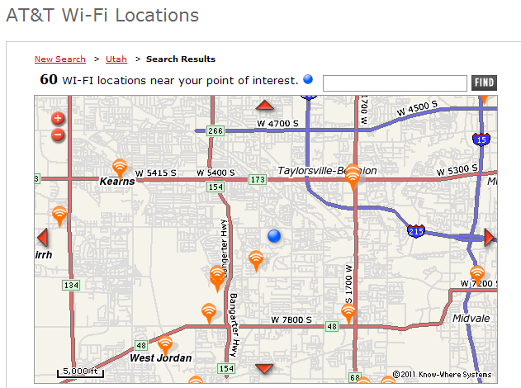
Starbucks (closed outlets) Borders (out of business) Barnes & Noble (?) McDonalds (pay to play)

Slide 24
Federal Telecommunications Act of 1996 barred health issues for non-ionizing radiation, provoked immediate moratoria and the emergence of a grand contradiction that persists today: Wireless infrastructure is regulated by how it looks more than how it works. Communities regulate wireless – what if wireless rated them?
Allred observed the “great disconnect” in policy planning as early as 1996 - still not resolved as of 2011.
Non-ionizing – not enough energy to remove an electron from an atom or molecule

Slide 25
What is 4G? ^{4th} generation technology (perceptional and contextual) 256-768 kbps (compare to “broadband” defined as transfer speeds at 1.5mb/sec or higher) Analog Voice→Digital→Data Packets (VoIP) 100 mbps to 1.0 gbps (depending on mobility of target) WiMax, LTE, MIMO, GSM, HSPA, HSPA+…is marketing ahead of deployment? Deployed in Armenia, Sweden, Uzbekistan and several other countries Can democracy 2.0 go as many-to-many if upload speeds are radically slower than download?

Slide 26
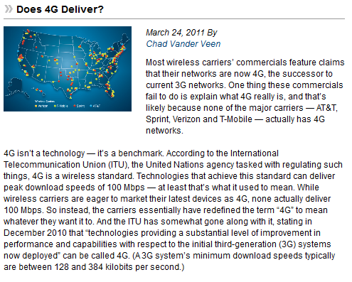
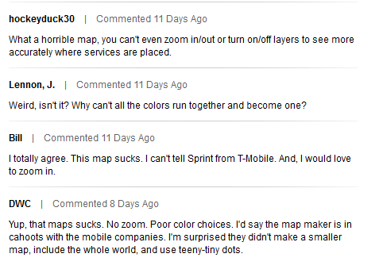
From Govtech.com
No one in US actually has 4G service?
Source: http://www.govtech.com/
newsletters/4G-Map.html
Is 4G not a tech – but only a benchmark - -
anything better than 3G
People gripe about national maps – not enough detail or functionality for the “last mile.”

Slide 27
“Is Utah Ready for 4G”
could just as easily be
“Is 4G Ready for Utah?”
Customers are being sold on the idea of ultra low-cost high-definition seamless, universal video while driving.

Slide 28
Key to mobility is wireless – keys to wireless are line-of-sight and proximity. Issues: - multi-path - reflection - atmospheric moisture - vibration - path geometry & density - transmitter power - antenna direction & height - ground conductivity - beam tilt - earth curvature - other attenuation - neighborhood NIMBY-->

Slide 29
Customers want MAGIC Mobile multi-media Any-time, anywhere Global mobility support Integrated wireless solutions and Customized personal service.”

Slide 30
In 2010 20% of web traffic was streaming video

Slide 31
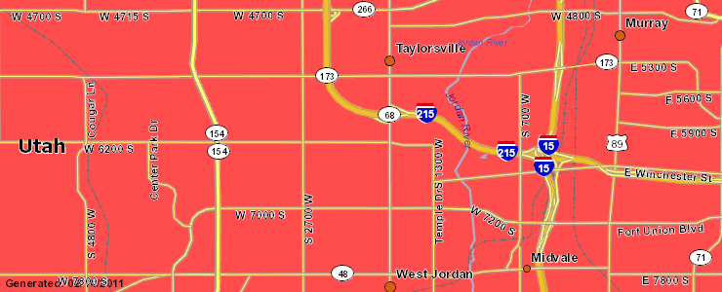
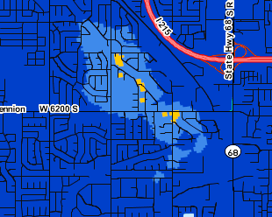
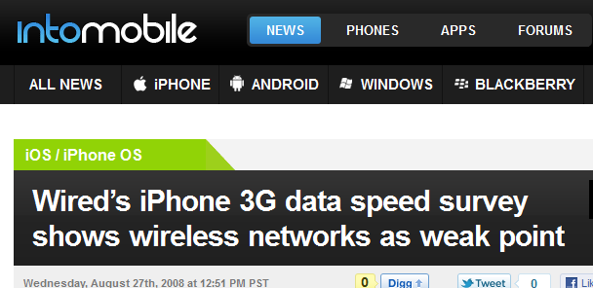
Typical advertised coverage map by wireless carrier

Slide 32
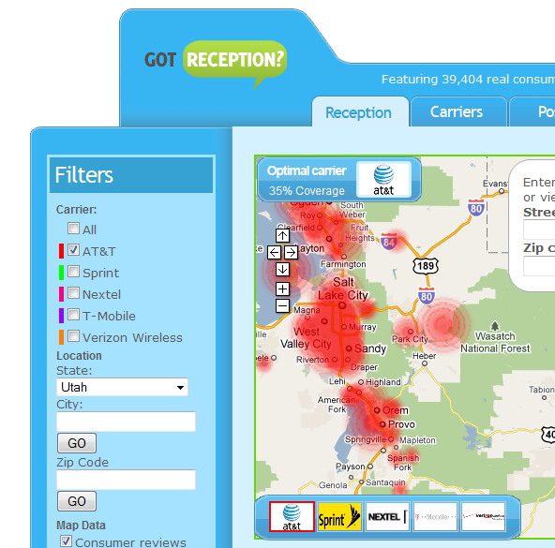
National map process may be key to unifying standards for display, analysis and marketing that informs the regulatory process in a way that is safe for wireless providers, useful for customers and supportive for balanced regulatory processes at quazi-judicial/municipal level.

Slide 33
Mapping services could benefit from unifying standard

Slide 34
“Line of site to a DIGIS access point is required. Many factors affect speeds.”

Slide 35
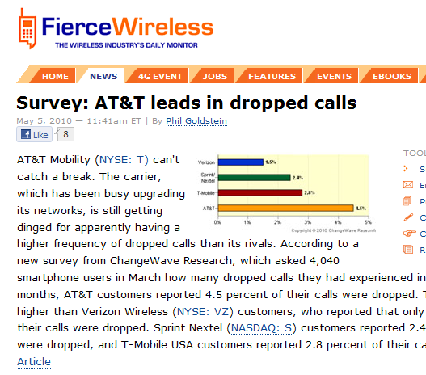
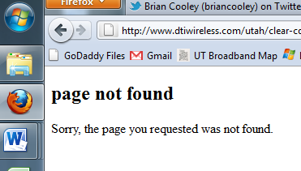
Market surveys are typically neither scientific nor comparable
Carrier coverage maps often ‘crashed’ or were otherwise un-helpful.

Slide 36
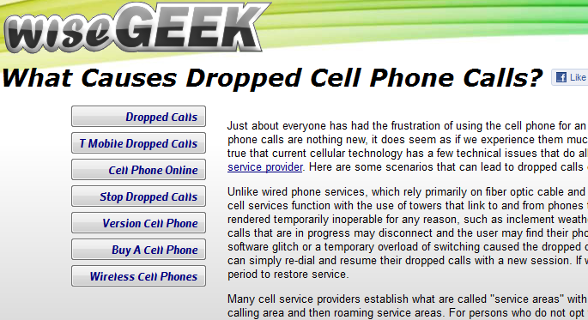
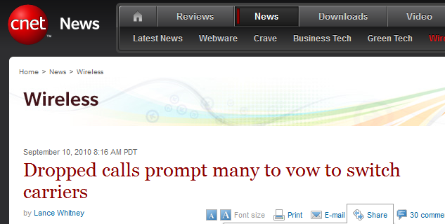

Slide 37
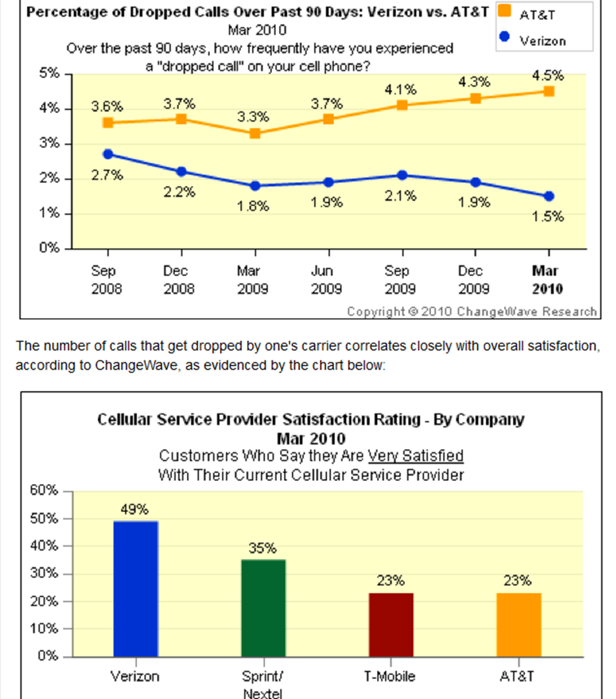
Possible widening percentage of dropped calls before the apparent deluge of “high def” demand
Apparent declining satisfaction before the expected deluge

Slide 38
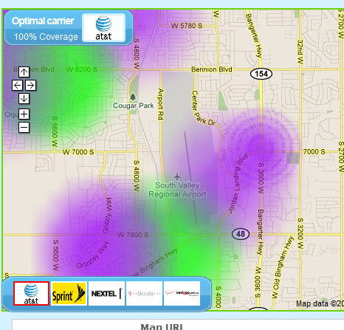
This map had some useful potential, by texturing mobile coverage, and may be based on some genuine underlying GIS
Can anyone improve on Android phone app for enhanced signal measurement?

Slide 39
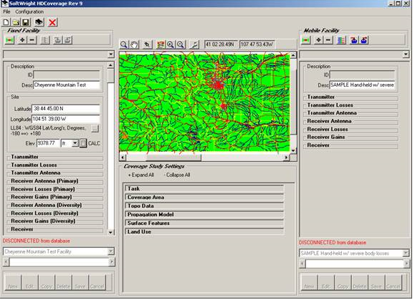
These people were responsive to requests for sample design – however, their free download would not run.

Slide 40
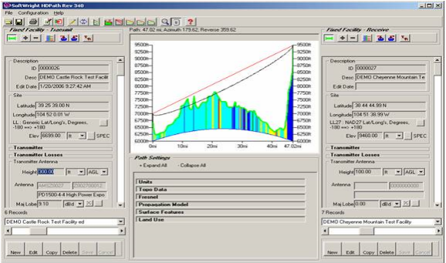
Can commercial-provider RF signal be displayed for the public, rather than just for engineers.

Slide 41
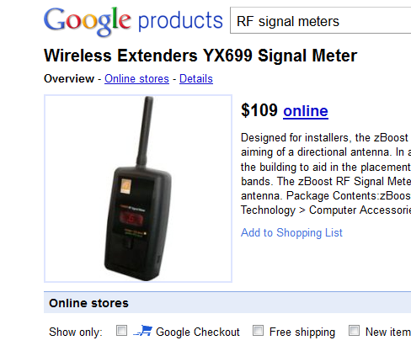
Specialized RF signal meters supplant clumsy use of cell phone bars. Tech Web traffic includes Twit ™ news on iPod antenna/display controversy). How well does the “active cell update indicator” on smart phones anticipate dropped calls?

Slide 42
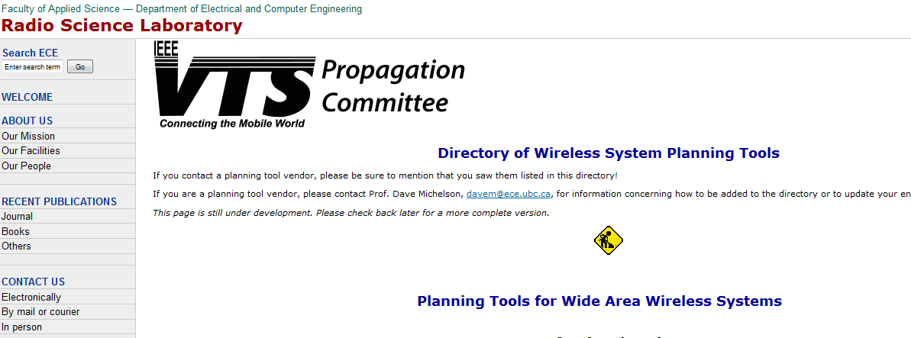
Further catalog of RF resources

Slide 43
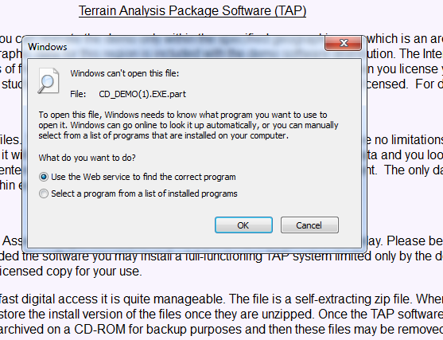
Many sources have embedded Esri software. No demo downloads ran successfully. Is there a spearhead role for AGRC/Esri in promulgating a model for ‘best practices’?

Slide 44
Allred note: Randy Frantz on Esri for broadband/wireless references.

Slide 45
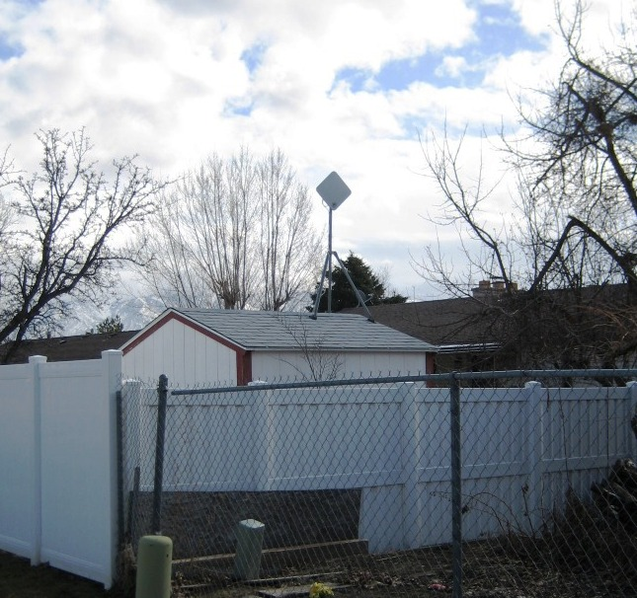
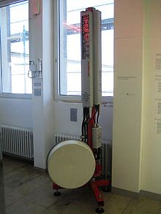
National broadband mapping revealed wide variety of carriers and technology types.

Slide 46
GIS as a tool for Democracy 2.0
UK ranking towns by broadband speed – marketing quality-of-life
Infinite democracies
Perhaps democracy is now all about electronic speed – as power to get things done

Slide 47
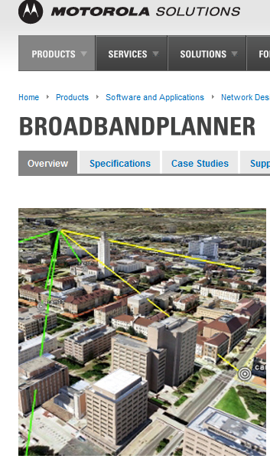
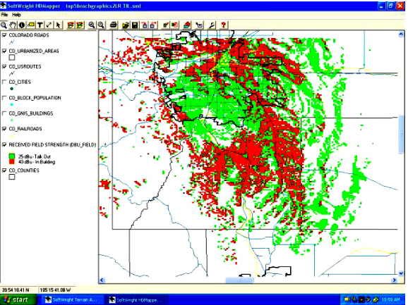
Motorola campus concept – defining social relationships by wireless geography.

Slide 48
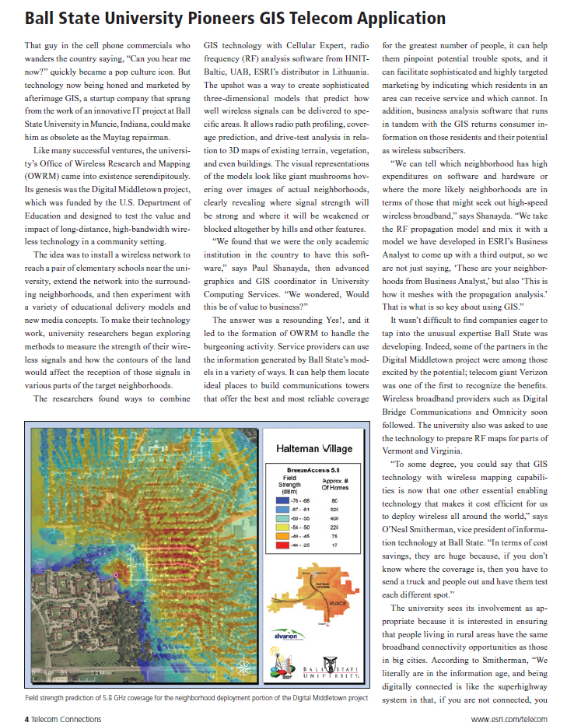
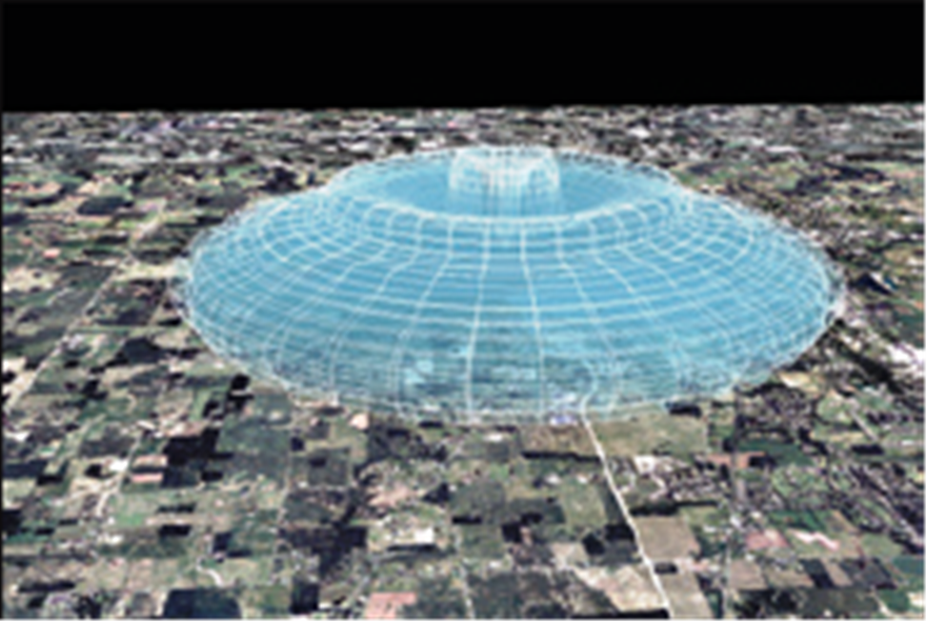
Pro-active community design: faculty and students want to be wireless everywhere – tests crash:
Implication:
Private campuses
Private communities?

Slide 49
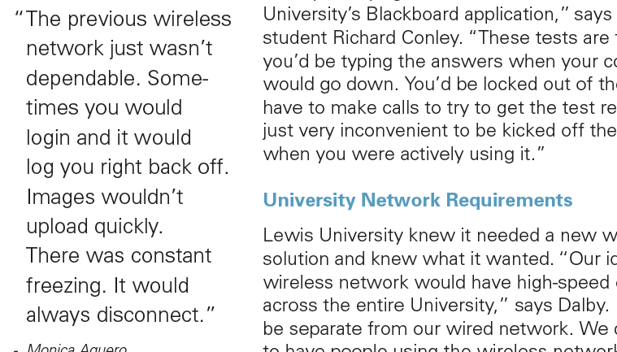

Slide 50
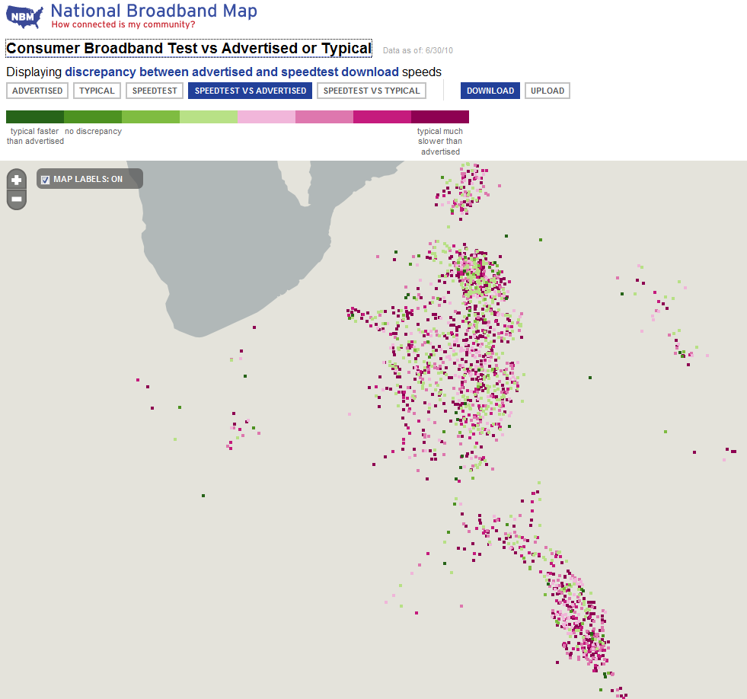
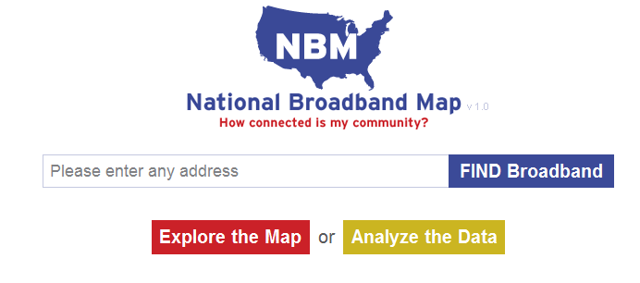
The game of measuring speed.
If wired is slow then is wireless even slower?

Slide 51
Visualizing
the argument
for speed?

Slide 52
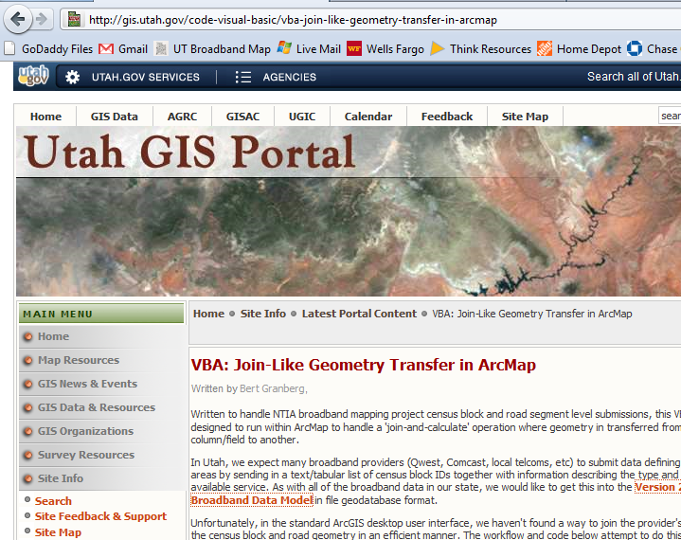

Slide 53
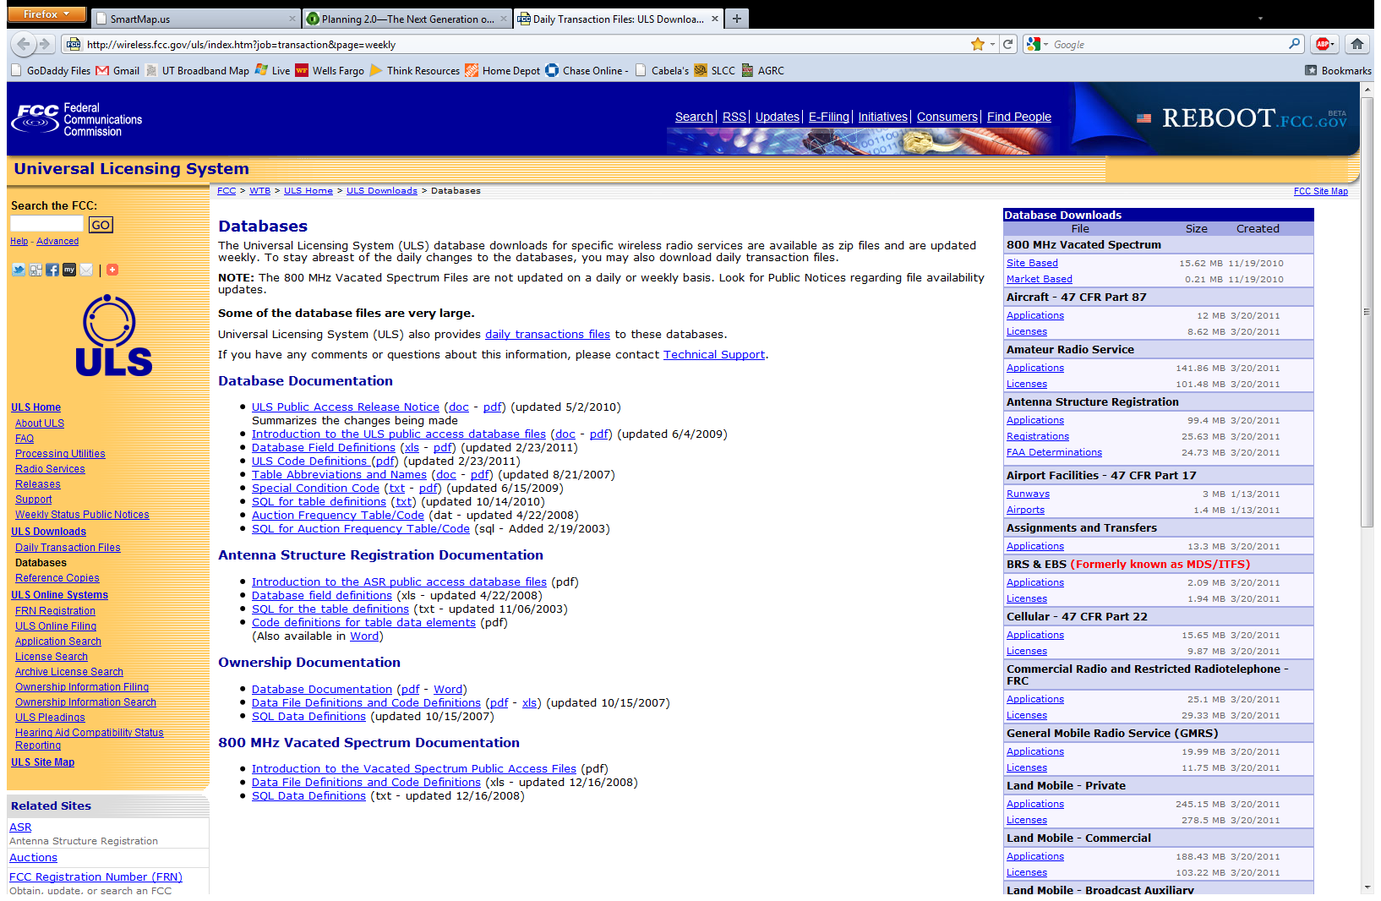
2009 version of FCC tower database

Slide 54
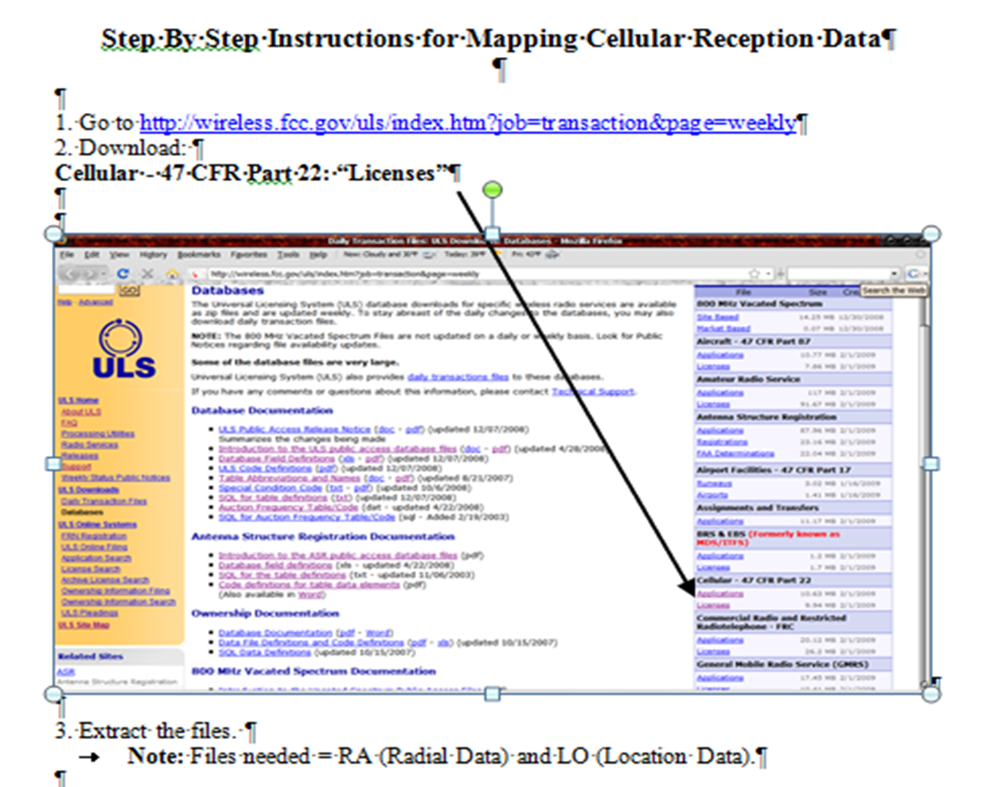

Slide 55
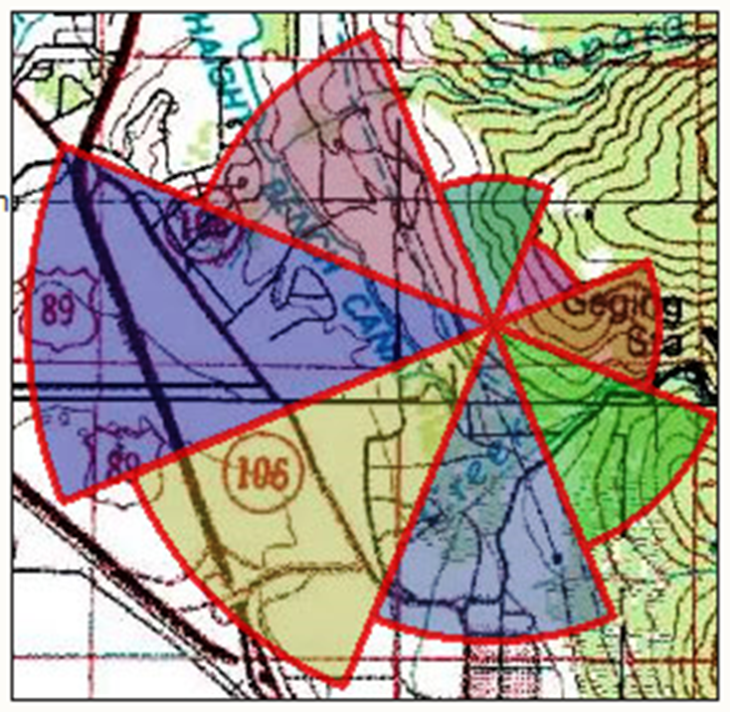
Conceptual thinking has come a long way from azimuthal sectors over paper topos:
2009 FCC “tower” database might best work “bottom up” – local initiative supported by regional resources.
Land use inventory for regional broadband service planning could be modeled as per WFRC for highways.

Slide 56
How might local land use inventory apply here?

Slide 57
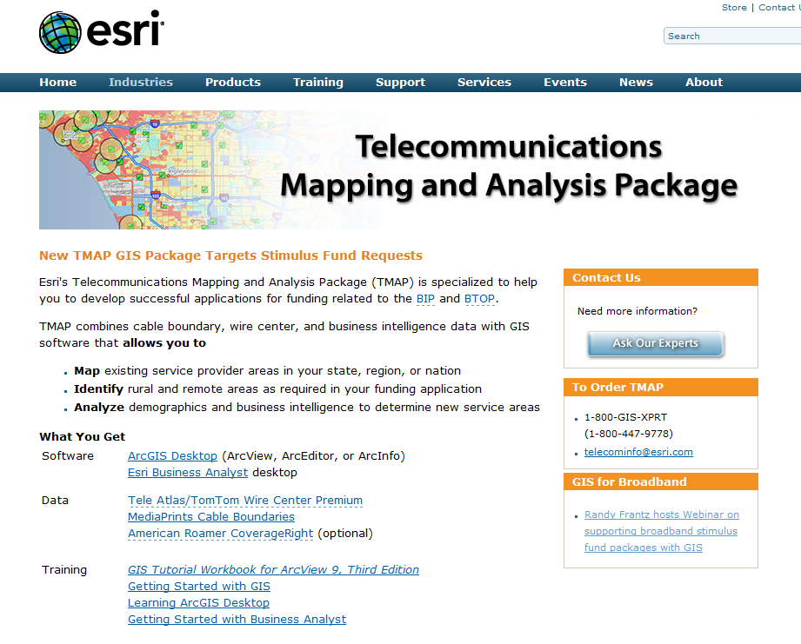

Slide 58
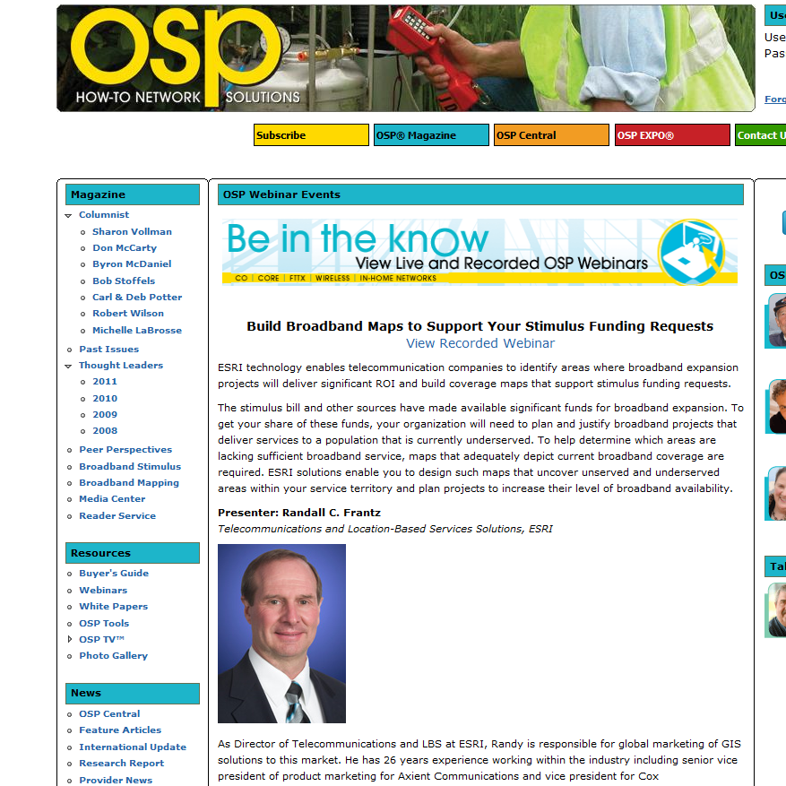
ESRI featured in network industry magazine – build GIS maps for advocating broadband stimulus funding

Slide 59
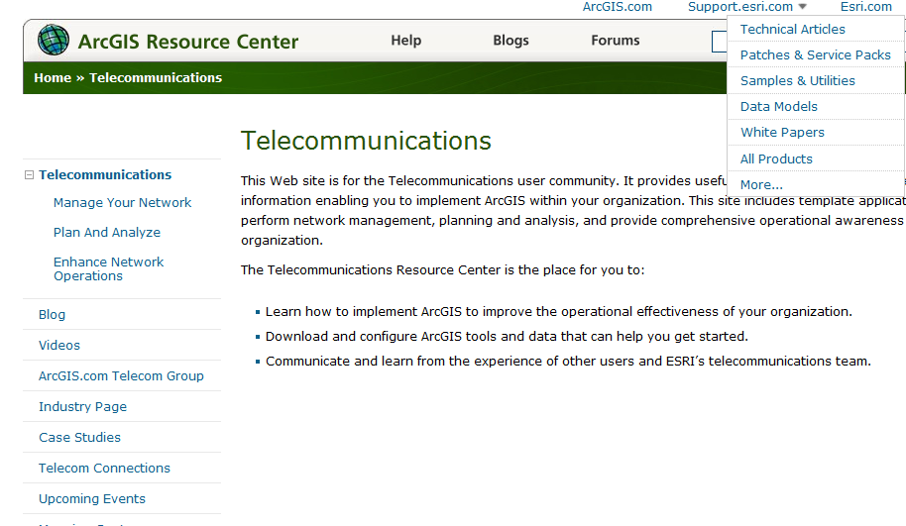

Slide 60
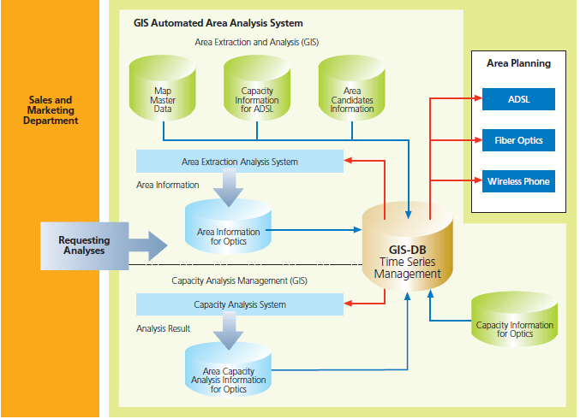

Slide 61
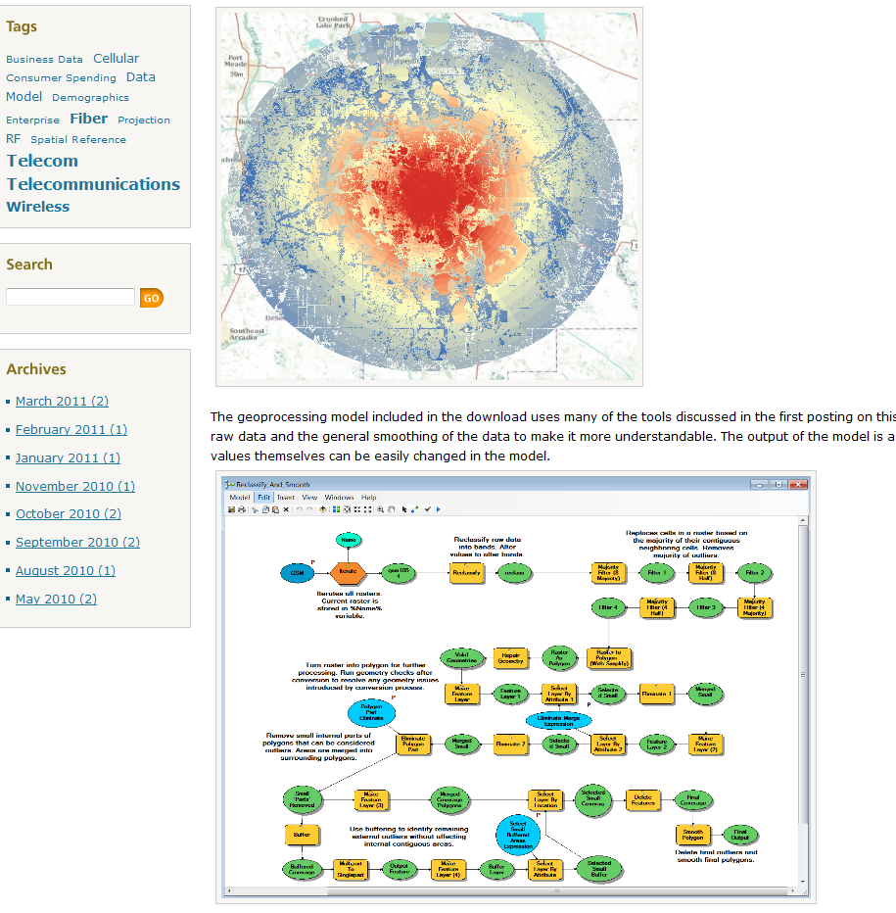
Hardware and software are ubiquitous - -
Why not promulgate a model set of
“best practice” routines and display methods?

Slide 62
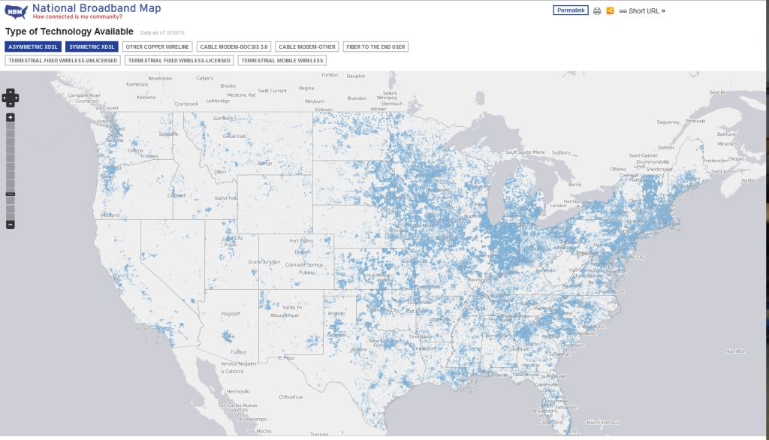
How well might national mapping reveal local conditions?
Everything is local anyway, so why not start there?
People know their neighborhoods better than anyone.

Slide 63
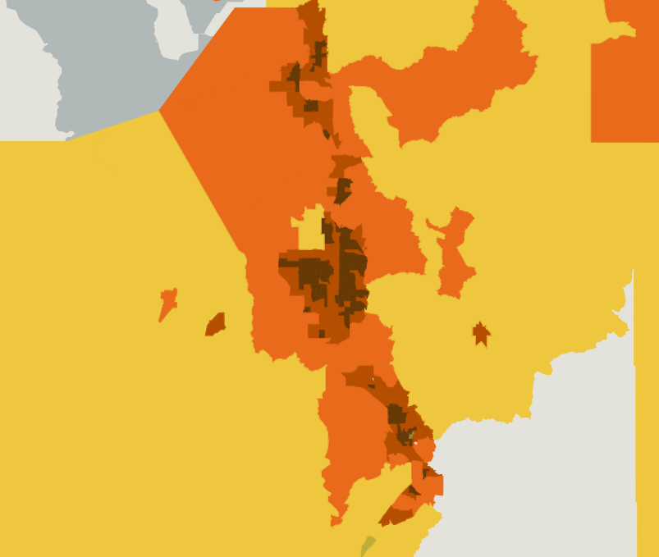
Getting to the last mile
This part of the broadband map normalizes access speed by population density.
There are no labels, ID tool or other functionality and data is at gross scale.

Slide 64
We observe that sliding the “download speed” bar up or down we go from apparent full coverage to apparent zero coverage. We also observe that upload speeds lag down-load speeds, suggesting an implication for “many-to-many” relationships in Democracy 2.0.

Slide 65
Sample of Utah’s broadband mapping for one company – note on-off results and apparent “holes” – rather than gradient coverage.

Slide 66
Sample of Utah’s broadband mapping for a mobile wireless provider – note on-off results and apparent “holes” – rather than gradient coverage.

Slide 67
Begin conceptualizing local model from national model

Slide 68
Federal Version – “virga”?
We created this map and pie chart from downloaded NBM data.
Results are spotty and content lacks detail.
Full FIPS (Federal Information Processing Standards) table join on 2010 Census Data from downloaded CSV text file.

Slide 69
2011 FCC Map Partnering with ESRI
Some focus on speed test while moving at high speed - - direct inverse relationship

Slide 70
Mid-stream Conclusion:
If you spend a lot of money, you can get a great map that means something at your level – the famous “last mile”.
National mapping is closing the gap toward that last mile.
Meanwhile, what can you get for “free” using already-deployed desktop GIS?

Slide 71
Where carrier coverage maps loaded reliably we were able to confirm their “dead zones.”
ArcMap findings matched very well.

Slide 72
Step back for a moment to citizen’s level – Example: Google Earth – The Old Part of What’s New

Slide 74
Allred wireless planning in 1996
2011 - Using hyperlink for map displays on visual line-of-sight as required in some ordinances (Park City) and implied by many others. At minimum, a major component of RF signal planning.

Slide 75
Select a suburban target area – terrain, traffic, growth
A wide variety of data sets is available from AGRC. We encountered few file conversion or compatibility problems.

Slide 76
Sporadic apparent
LiDAR
reflection errors
Acceptable 1st run/last run LiDAR loss?
ArcMap has strong display and visualization options.

Slide 77
Crucial wireless features and obstacles. Re-insert lost LiDAR features by clipping contours and inserting concentric circles and edit elevations – both real and for modeling.

Slide 78
Contour data calculated from 2m LiDAR with important lost features digitized back in.
Sites where LiDAR “lost” the infrastructure were re-digitized in ArcMap

Slide 79
Forget Andy Warhol –
we can get more than 15 minutes of fame with ArcMap ‘art’

Slide 80
Allred wireless database supplants incomplete municipal site records, poor legacy files and lost “institutional memories”

Slide 81
Antenna height, equipment conflict for line-of-sight.
Only 11% of available “slots” were above elevation minimums.

Slide 82
Allred’s Project

Slide 83
RED = No FIPS - 15 digit ID#
14,935 Census Blocks in SL County – from downloaded data 7,238 = NULL
We worked around missing or unusable data – probably resolved since? Downloaded data extracted into three text files – at 2, 21, 122 mb in size – wireless data was about 75 percent of the data volume.

Slide 84
2000 Census Data
GIS mapbuilding issue:
2010 Census Data
Data resources should
be regarded with care

Slide 85
Tower Analysis Process
Inputs:
Tower x, y, z – NAIP
Industry decay stds meter buffer rings (dissolve function replicates handoffs)
2 meter LiDAR – bare earth.

Slide 86
Playing with the data, searching for relationships, testing alternatives based on common framework wireless industry standards Intersect Tool in ArcToolbox was key
Known wireless antenna sets in project area.

Slide 87
3D analysis Viewshed for two simulations using 2 meter bare-earth LiDAR data: 1. Minus eight meters to account for generalized suburban tree and building heights – 15 cellular tower observer points 2. Plus eight meters to investigate potential improvement in line-of-sight results – 17 tower observer points (two added for improved coverage) Using 3D Analyst calc’d viewsheds for varying height profiles Reclassified into separate visible/non-visible layers and converted into vector contours. Viewshed for total visibility – Line of Sight for vantage point scenarios often requested by local planning committees; Photo sims for visualization

Slide 88
LiDAR to contour to TIN
Buildable envelop as visible 3D space
Existing wireless sites
Re-digitize LiDAR- lost water tanks

Slide 89
On/Off vector data intersected with multi-ring buffer & color symbolization to simulate signal decay.
Line-of-sight visibility
Non-visible
Intersect Tool

Slide 90
Combined visibility (ramp cellular tower heights in meters AGL, with and without obstructions)
Zoom for site
specifics versus network architecture

Slide 91
Key idiosyncracy – signal can bend and penetrate buildings, but attenuates rapidly when combined with distance decay. We successfully modeled this data intersection.
We noticed patterns of how wireless antenna are installed on poles, the general inventory of available slots and then modeled those observations in ArcMap.

Slide 92
Potential for Community Decision Tools
“Red Balloon” Tests – often helpful for visualizing wireless options.
We had trouble integrating raster and vector, and GIS functionality is not universal across 3D and ArcScene.

Slide 93
Integrate zoning and land patterns across jurisdictions
Converting “dry” language text into visual terms
How well do neighborhood standards match network architecture?

Slide 94
Integrating land use with terrain

Slide 95
Rapid iteration modeling to evaluate selections based on intersections or unions of criteria: terrain, RF signal, land use controls, lease availability
Site orientation to dead zones

Slide 96
Buffer tool for variety of municipal regulatory reviews, directly comparable with both land use and zoning.
Match to sensitive land uses

Slide 97
Integrate with existing query functions for public notice mailings, etc.

Slide 98
Analysis of combined effect of multiple constraints.

Slide 99
The confluence of all constraints can be made visible

Slide 100
Buildable envelope visualization for comprehensive visualization of constraints

Slide 101
Cross-jurisdictional analysis – wireless signal on a usable market basin basis.

Slide 102
Using LiDAR-based terrain, ArcMap “signal” can replicate “look down” on roadways and under freeway overpasses - - more implications for “line-of-sight” and distance decay
RF signal passes under freeway overpass just like in “real life” - - modeling usefully done in ArcMap.
Modeled building envelope
(not a building but
buildable RF airspace)
Freeway overpass
On-the-fly, citizen-level visualization of RF signal “flow” between BTS and mobile user

Slide 103
Desk-top GIS Visuality vs RF Signal Simulation
Allred version - ArcMap for signal visualization with land use layer
Sample of commercial RF propagation – no land use regulation layer
Not intuitive color scheme and questionable propagation results

Slide 104
Using ArcMap symbolization for “data mining” with or without the Toolbox

Slide 105
Line-of-sight in 3D Analyst – an alternative to ArcScene for evaluation of sensitive viewscapes or RF signal issues.

Slide 106
Hand-held signal strength patterns in a known “dead zone” for wireless – added as a feature class in ArcMap over NAIP 2009.

Slide 107
ArcMap conversion of
points to lines

Slide 108
VGI – “crowd-source” could resolve the apparent shortage of data points for effective thematic map of “dead zone.”
Apparent level of accuracy is not warranted by the data.
Error in precision

Slide 109
Geo-reference wireless provider map for ArcMap analysis
How to evaluate genuine 4G availability?

Slide 110
Georeferencing accuracy at wireless signal relevancy

Slide 111
Strong correspondence between actual wireless coverage map and ArcMap analysis of RF signal on terrain
Alleged 4G spot shortage?
Evidence that a first-cut use of GIS can provide analyze and display RF signal in conjunction with constraints.

Slide 112
Excellent community resource relegated to “grandfather” status
Some of our best community facilities have been relegated to “non-conforming” status – our system could get weaker before it gets stronger

Slide 113
Visualizing constraints starts with seeing crowded facilities – then evaluating “cramped” signal options.

Slide 114
Urban Limits 1996 - 2010
Land use encroachments include residential aesthetics and aviation “invisible” flight pathways
Burdens on wireless are complex

Slide 115
What is genuinely visible and what is imaginary expectation fueled by over-emphasis on aesthetics over function?

Slide 116
Is the industry hampered, even as a potential wave of new demand reacts to marketing?

Slide 118
Tower crowding – expense and compromise

Slide 119
Relevancy of line-of-sight as a genuine constraint on signal more than aesthetics.

Slide 120
Visual analysis for promoting reasonable regulation in dynamic markets.

Slide 122
Visualization for hidden opportunities for RF improvements at no net neighborhood impact.
Value Analysis:
Identifying the highest value site at lowest impact and system cost.

Slide 123
The national Broadband Map effort revealed a wide variety of providers and tech systems.
Land use regulation tends to view most of them as “ancillary residential” or otherwise.

Slide 124
Solo amateur “ham” radio operators are sometimes accorded more “envelope” than commercial providers that serve mass customers

Slide 125
What about the American Planning Association, AIA, ASLA, ULI, and others?
National organizations
“talk the talk”
but how well do they promote genuine regulatory sensibility?

Slide 126
There is considerable focus on the uses of mobile communications, but constraints by regulation continue as if there were no connection between mobile communication and aesthetic constraints.
State and regional organizations can promote genuine modeling capability using a balanced set of criteria: function supported by form.

Slide 127
Land use policy evaluation of wireless as per aesthetics rather than science.
Sponsored by “Scenic America”

Slide 128
We think that the argument is more than a struggle between “convenience” and hazard. For most people and most organizations, mobile communications is a necessity.

Slide 129
Local Land Use Planning Policy and Law
The history of land use planning in the United States has been “Euclidean” – separating land uses. In contrast, GIS inherently integrates.
We did not find any Utah municipal comprehensive plan that provided enabling language or policy to guide land use controls, including zoning. Aside from questions of planning law, if the broad design of communities ignores wireless, then it is not surprising if zoning ordinances often do also. Where zoning does control, the language is strongly conservative.
Most regulatory language is scattered across definition sections, supplementary and qualifying and through-out widely varying zoning types. GIS provides easy tools for visualizing these in combination.
We found that GIS symbolization tools were the strongest aspect of using GIS to integrate wireless with terrain and land use controls.

Slide 130
Competing Policy Issues
Wireless providers appear very interested in quickly reinvesting cost savings into systems that are vulnerable.
Restrictions to building mounts do not help if there are not buildings.
Buildings create obstructions that limit their value as mounts.
Many ordinances require submission of wireless plans, very different from requirements for establishing a shoe store.
Few local units of government have GIS or other databases that focus on the range of needs inherent to wireless. There is no “champion” for inventories and network tracking for communications parallel to more traditional networks for water, sewer and roads.
Enterprise-level GIS can apply to municipalities as well as private business - disconnects abound in both: wireless engineers have to filter through marketing, site management, and sales. The same is true within City Hall. GIS is a bridge.
We wonder about the possibility for ArcReader, ArcExplorer and ESRI Community Maps, along with Google Maps and Bing to further extend GIS tools to the neighborhood level.

Slide 131
GIS software has some capability for various forms of “photo sims” and other visualization tools ‘hyperlinked’ in features classes.
Real-time modeling can support policy plan design scenarios and regulatory site plan reviews, particularly for difficult conditional-use standards.

Slide 132
(1st Run Sample) Park City, UT – related Telecommunication Ordinances

Slide 133
Ogden City – related Telecommunication Ordinances

Slide 134
Utah County
City of Orem
City of Moab

Slide 135
This “model” community actually has much more restrictive separation requirements than most.
No surprise that wireless planner laments that the ‘model’ is not getting used.

Slide 136
Sample Ordinance Modifications
“Transportation Objective 4.5.1: Develop a greater recognition and understanding of the relationships between land use, economic development, community identity and transportation and communication facilities.
Community planning is heavily involving in marketing for business investment. We found no evidence that communities want business investment by the wireless industry, perhaps because the service is not “visible” but the antennae are.
Planning language may tout a community as “#1 in community baseball” or “business-friendly” – visualization could make such marketing terms more inclusive. It’s great to be the sugar beet capitol of the world - - what about the being fastest wireless network in the west.
Instead, wireless providers routinely disclaim with “not available in all areas.”
“Free-standing wireless antennae may not extend above heights for all uses in <zone> or 70 feet, whichever is less.” <by definition, antennae may not rise above line-of-sight obstacles, or worse.
Utah League of Cities and Towns has model ordinances and other tech help for such things as street trees and wind generators. No evidence was found in support for communication technology design allowances.

Slide 137
In many ordinances, wireless facilities are regulated with much of the same language and terms for such things as “Class A Beer” outlets and ‘dog and cat grooming.”

Slide 138
- Regulatory reform could have a multiplier effect on reducing some very costly aspects of networks: being held “hostage” by land owners for prime sites in markets that are more constrained than they appear. - Consistency across jurisdictions in plan approval requirements can reduce business cost by bringing time-saving economies-of-scale in preparing and negotiating land use entitlements. inherently, private companies do not want to reveal sensitive information about apparent business weakness in order to make an argument for business approval. - inherently, buying shoes at a shoe story doesn’t depend on how many shoe stores are nearby – but for people buying wireless service, the network of service outlets is crucial. This unique condition begs the question of regulating wireless using different tools. GIS visualization could be one of those tools. - desktop software and hardware can go a long way if umbrella organizations assist in development of “apps” and specifications for spatial modeling. ESRI is moving in that direction on many other fronts, including utility networks that could easily include wireless.
A Few Conclusions

Slide 139
Conclusions, con’t.
Being able to take control of visualizing wireless networks makes the consumer and local government more able to take responsibility for a neglected aspect of system evolution.
Visualizing wireless creates a “negotiable landscape” that is more textured, more responsive and provided more options.
Land use control can be more viewed as “land use opportunity” when wireless can be visualized by how the service looks rather than just on how the antenna looks.
Regional organizations that routinely maintain inventories of land uses and promote regional policy cooperation could include wireless as a community asset rather than a neighborhood-level NIMBY nuisance.
GIS groups already have relationships with allied organizations: AIA, APA, ASLA, LCT, ICMA, CPP, Envision Utah, AGRC, COGS. The structure exists.
Our own workflow begs for continued development for workflow, scripting and model building.

Slide 140
Conclusions, con’t.
Land use reviews can involve as many as four different sets of reviewers, including citizen groups, review committees, quazi-judicial commissions, legal counsel, and elected officials.
Reviews can take months, adding to uncertain and overhead cost. Meanwhile, technology and customers move on.
Improvements in wireless BTS entitlements can promote readiness for DAS systems that will require much more complex reviews. Once again, GIS is already well-developed for mapping, displaying and modeling underground networks.
Ironically, developing countries may be moving faster at deploying 4G because they are not burdened by legacy systems and local regulatory complexities.
International money may find developing markets more profitable.

Slide 141
A few observations about hardware and software
We probed the edges of how much data we could process. Crashing, freezing and long processing times occurred at the extremes of data size and complexity of analysis.
We wonder what we could do if we had a better video card, more RAM, or if ESRI went to 64-bit architecture.
File management in GIS is a crucial factor. We did we put the 500 files we created.
Further research could confirm the ubiquity of GIS capability at the desktop level in virtually all Utah organizations that regulate communication facilities.

Slide 142
State of Utah
Benchmarking City Performance
Emerging & Sustainable Tech
Wireless & Mobile Broadband
Apparent strong awareness of leading-edge technologies but no direct support for wireless architecture at community level.
Smart Highways, Smarter Drivers
Digital Communities

Slide 143
See us at:

